Slide 1


Sales Performance Analysis of Walmart Stores
Yugma Patel

Slide 2


INTRODUCTION
The data includes customer demographics, product lines, sales amounts, and payment methods across multiple branches.
The analysis addresses ten business tasks, including identifying the top-performing branch by growth rate, finding the most profitable product lines, segmenting customers by spending levels, detecting unusual transactions, and determining the most popular payment methods by city. It also explores monthly sales distribution by gender, product preferences by customer type, repeat purchase behavior, top customers by revenue, and sales patterns by day of the week.

Slide 3
BUSINESS PROBLEM
Walmart aims to optimize its sales strategies.
The analysis focuses on identifying sales trends, customer segmentation, and product profitabilit

Slide 4
DATASET DESCRIPTION
Dataset includes:
Branch-wise sales data
Customer purchase behavior
Payment methods and product lines
Sales volume and transaction trends

Slide 5
Task 1: Identifying the Top Branch by Sales Growth Rate
Branch A showed a positive average growth rate with 2% it the top-performing branch in terms of monthly sales expansion.
Growth Rate= Current Month Sales−Previous Month Sales ×100%
Previous Month Sales

Slide 6
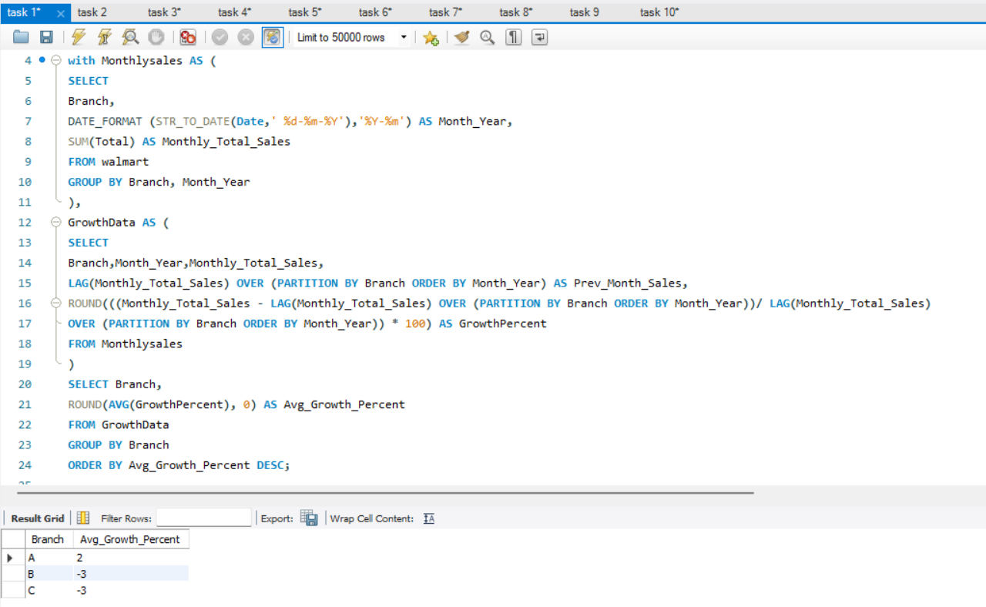

Slide 7
Task 2: Finding the Most Profitable Product Line for Each Branch
Branch A: Highest profit from Home and Lifestyle
Branch B: Most profit from Sports and Travel
Branch C: Top earnings from Food and Beverages

Slide 8
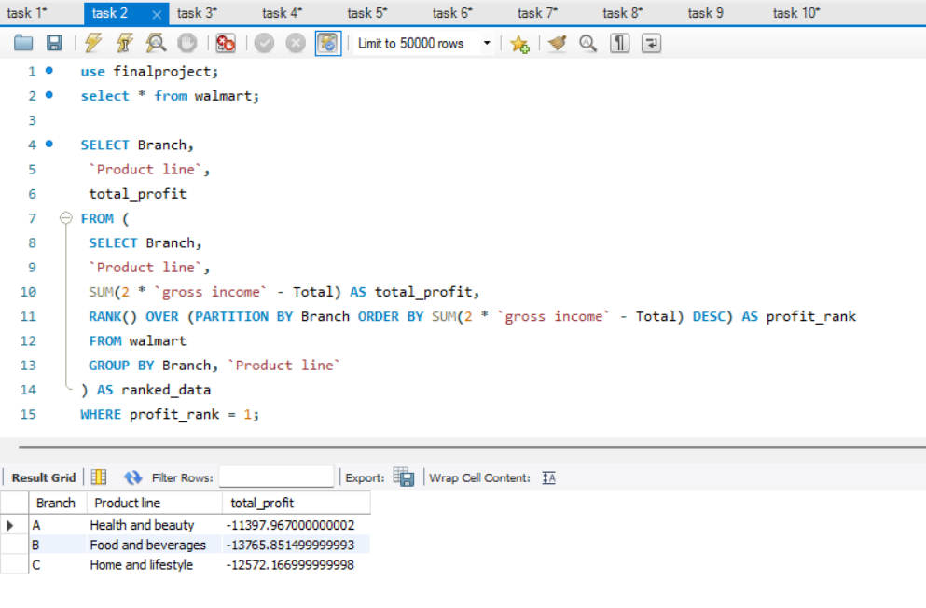

Slide 9
Task 3: Analyzing Customer Segmentation Based on Spending
Walmart segmented customers based on total spending:
High Spenders (> ₹22,000): Strong loyal buyers
Medium Spenders (₹20,000– ₹22,000): Consistent shoppers
Low Spenders (< ₹20,000): Casual or occasional buyers

Slide 10
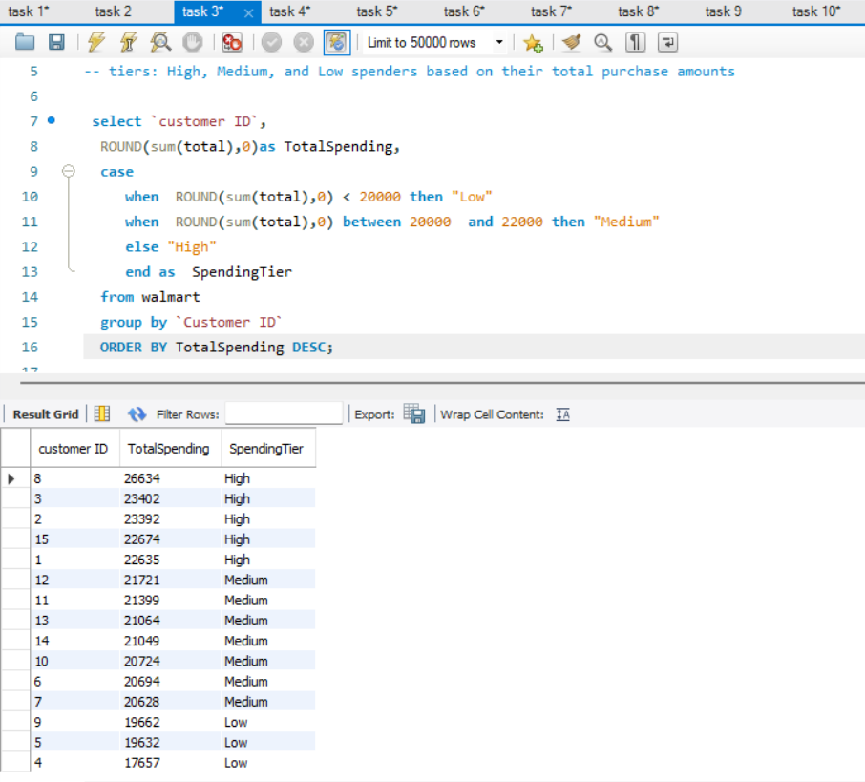

Slide 11
Task 4: Detecting Anomalies in Sales Transactions
Some transactions were flagged as “High Anomaly” – unusually large purchases.
Others were labeled as “Low Anomaly” –unusually small purchases.

Slide 12
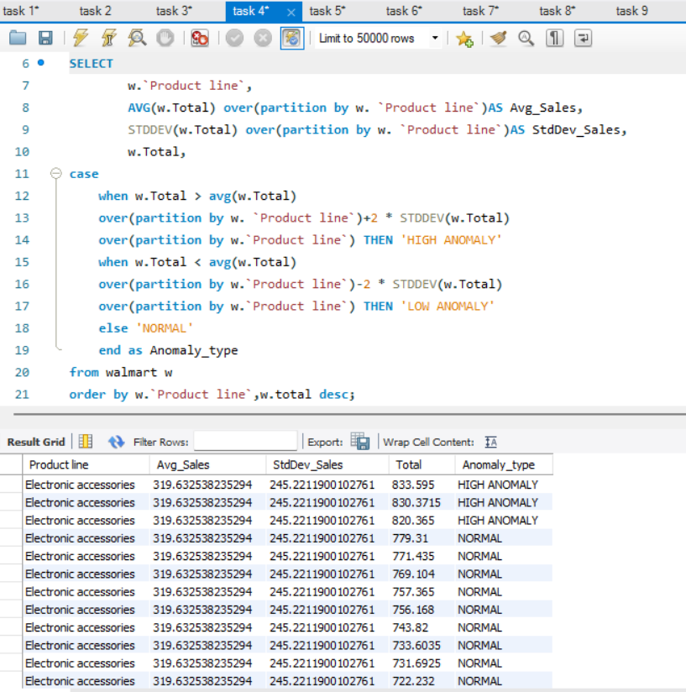

Slide 13
Task 5: Most Popular Payment Method by City
Yangon and Mandalay prefer Ewallet payments.
Naypyitaw prefers Cash.

Slide 14
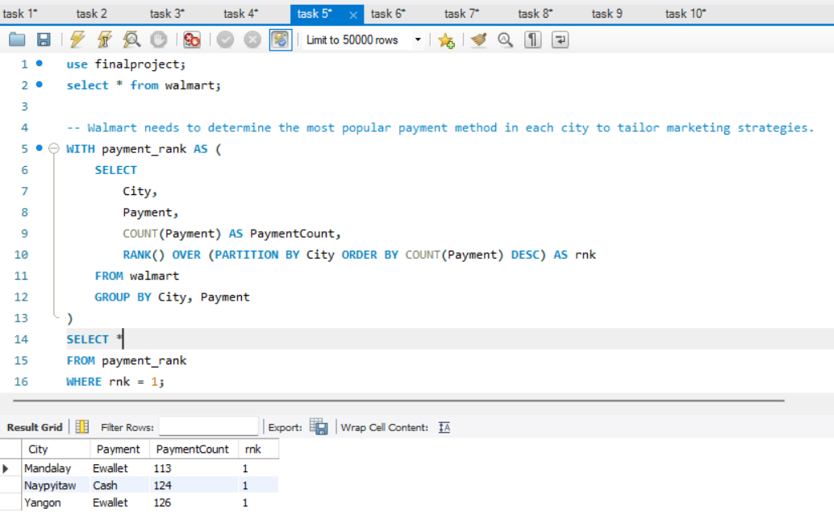

Slide 15
Task 6: Monthly Sales Distribution by Gender
Female customers consistently spent more than male customers each month.
January FEMALE customer spent highest 59,139
January MALE customer spent highest 57,153
○ Jan 2019: Female – 59,139 | Male – 57,153
○ Feb 2019: Female – 56,336 | Male – 40,884
○ Mar 2019: Female – 52,408 | Male – 57,047

Slide 16
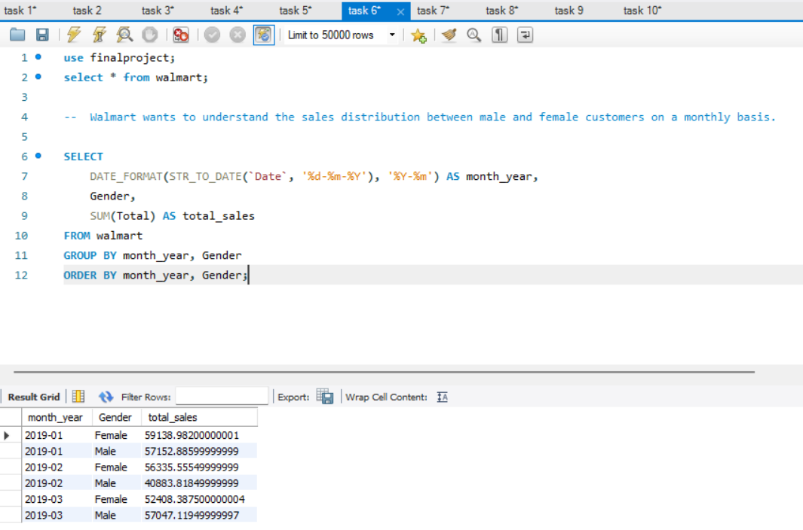

Slide 17
Task 7: Best Product Line by Customer Type
The query finds which product line earns the most for each customer type.
It uses SUM and ranks product lines by total revenue within each customer group.
Only the top product line for each type is shown.

Slide 18
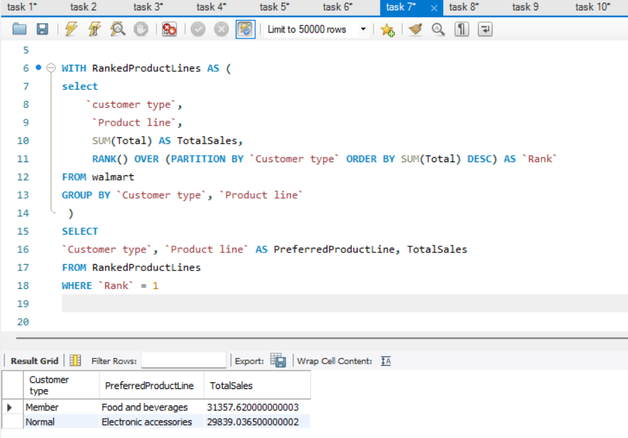

Slide 19
Task 8: Identifying Repeat Customers
The SQL query identified 15 customers who made repeat purchases within 30 days of a previous transaction. These customers have IDs: 15, 14, 13, 12, 11, 10, 9, 8, 7, 6, 5, 4, 3, 2, 1.
This pattern shows strong buying frequency and loyalty.
These customers are prime candidates for targeted marketing campaigns, loyalty rewards, or personalized recommendations to further increase retention and sales.

Slide 20
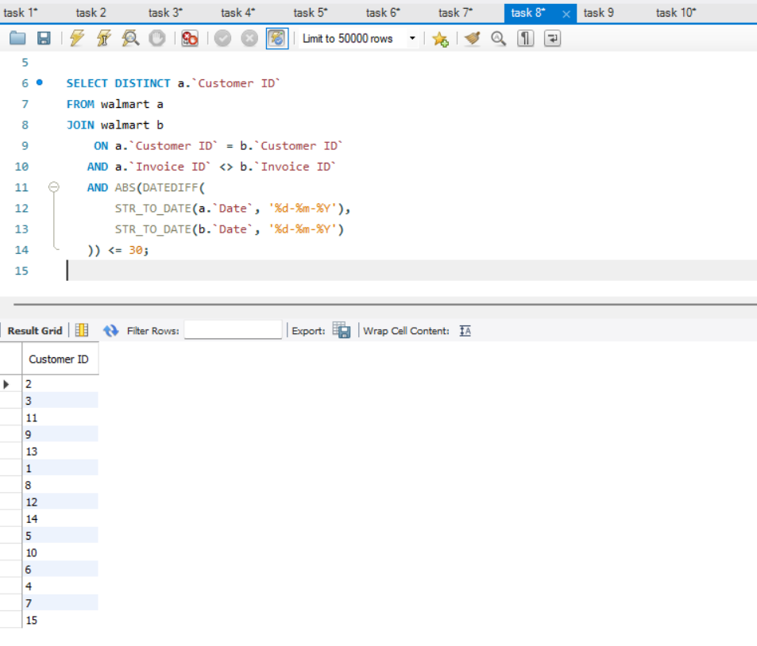

Slide 21
Task 9: Finding Top 5 Customers by Sales Volume
The query calculates total sales SUM for each Customer ID
It ranks them in descending order of revenue.
The top 5 customers are selected based on total sales.

Slide 22
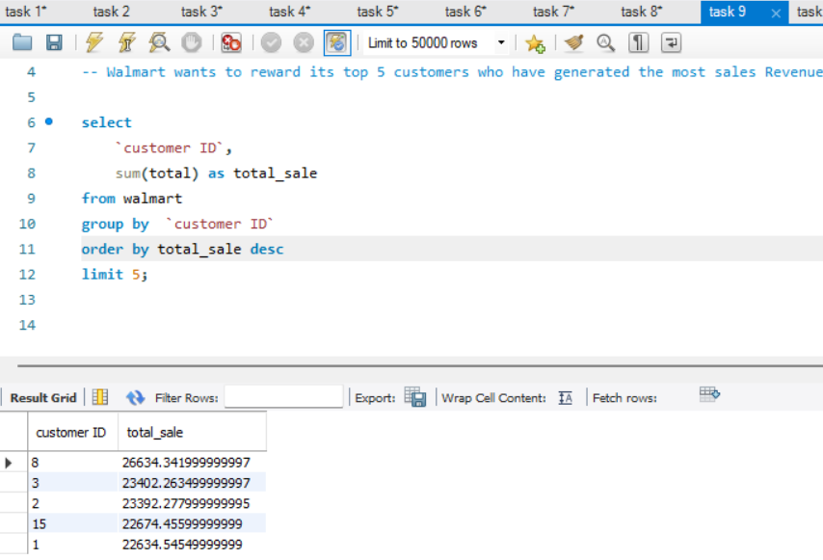

Slide 23
Task 10: Analyzing Sales Trends by Day of the Week
Saturday recorded 164 transactions with a total sales value of 56,121, making it a high-traffic and high-revenue day. This indicates strong weekend shopping behavior, suggesting that targeted promotions or special offers on Saturdays could further boost sales and customer engagement.

Slide 24
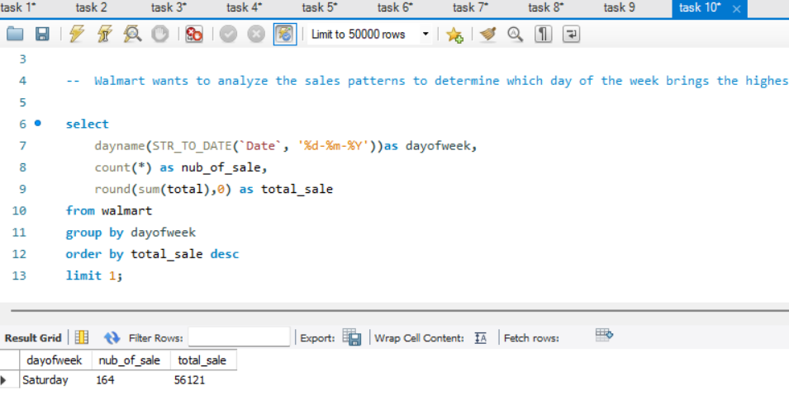

Slide 25
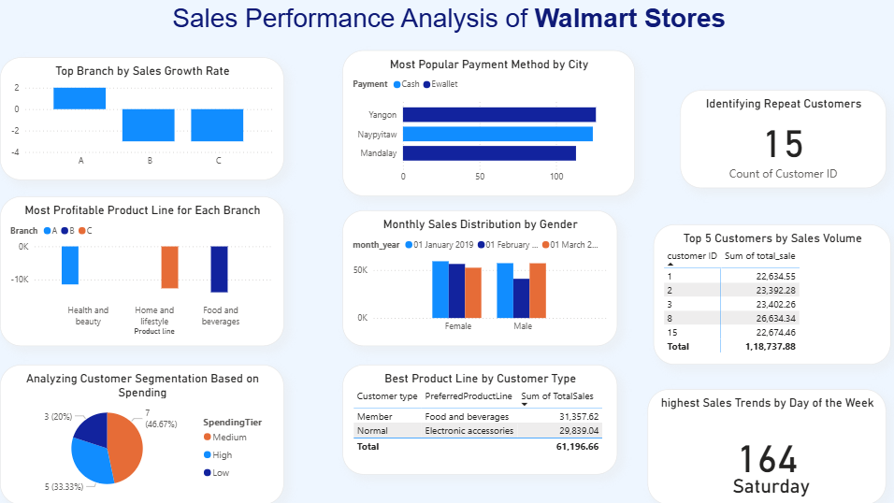
Analysis Dashboard of Walmart

Slide 26
Key Insights – Walmart Sales Performance Analysis
1. Top Performing Branch 🏆
Highest monthly sales growth rate identified.
2. Most Profitable Product Line 💰
Maximum profit contributor determined for each branch.
3. Customer Segmentation 👥
Customers classified as High, Medium, or Low spenders.
4. Anomaly Detection ⚠️
Outlier sales transactions detected against product line averages.
5. Popular Payment Method by City 💳
Preferred payment method identified per city.

Slide 27
6. Monthly Gender-based Sales Trends 📊
Male vs. Female sales trends tracked monthly.
7. Product Preference by Customer Type 🛒
Member vs. Normal customer product preferences analyzed.
8. Repeat Customers 🔄
Customers making purchases within 30-day intervals identified.
9. Top 5 Revenue-Generating Customers ⭐
High-value customers highlighted for loyalty rewards.
10. Weekly Sales Trends 📅
Most profitable day of the week determined.

Slide 28
Video Explanation Link
https://www.loom.com/share/2b8828f552fe4474aeca89eaae5708c3?sid=20b2c7a8-4c3a-4f48-8594-17263d84ebfa

Slide 29
Thank you
Yugma Patel

